Slide 1

SENTIMENTAL ANALYSIS FOR CRYPTOCURRENCY
INT 200 INTERNSHIP
TEAM DETAILS
SURIYA P S (E0121003) AIML
HARISH A K (E0121008) AIML

Slide 2
INTRODUCTON
LIBRARIES
DATA CLEANING
POLARITY & SUBJECTIVITY
NGRAM
ALGORITHMS
NAÏVE BAYERS
LOGISTIC REGRESSION
KNN
RANDOM FOREST
SVM
ALGORITHM COMPARISIONS
TIMELINE
CONCLUSION
REFERENCE
TABLE OF CONTENTS

Slide 3
INTRODUCTION
Sentiment analysis is a technique that detects the underlying sentiment in a piece of text.it is the process of classifying text as either positive, negative, or neutral. Machine learning techniques are used to evaluate a piece of text and determine the sentiment behind it whether it is positive or neutral or negative.
There are three types of sentimental analysis are
Fine-grained sentiment analysis
Aspect based sentiment analysis
Emotion analysis
Here we use emotion analysis to analyses the tweets from twitter to
compare between two cryptocurrencies

Slide 4
Cryptocurrencies
A cryptocurrency is an encrypted data string that denotes a unit of currency. It is monitored and organized by a peer-to-peer network called a blockchain, which also serves as a secure ledger of transactions, e.g., buying, selling, and transferring. Unlike physical money, cryptocurrencies are decentralized, which means they are not issued by governments or other financial institutions.

Slide 5
Cryptocurrencies Used
Bitcoin
Ethereum

Slide 6
LIBRARIES USED
pandas - To read the csv file
numpy - For counting purpose
tweepy - To access the twitter api in python
configparser - Allows program to customized config files
matplotlib.pyplot - For data visualization
TextBlob - For processing the textual data
WordCloud - To know frequency of word in textual format
Stopwords - To eliminate unwanted words
re - To get the matching values
Countvectorizer - To convert collected data to vector form

Slide 7
Nltk -To analyse textual data
String -To handle strings
Seaborn -For visualization
Wordnet -To find meanings for words
Tfidvectorizer -Helps to handle most frequent words
Metrices -To perform the model data
Train_test_split -Split the data to classification and prediction
Classification_report-To evaluate the performance of the algorithm

Slide 8
Getting Data From Twitter
Get access to twitter api key and access token
1
Generate data from twitter api using tweepy module
2
Authenticate with your credentials
3
Set up search query and collect data
4

Slide 9
Code for authenticating and collecting data from twitter
To authenticate as a user other than your developer account, you'll need to obtain their access tokens through the 3-legged OAuth
authenticate=tweepy.OAuthHandler(consumerKey,consumerKeySecret)
authenticate.set_access_token(AccessToken,AccessTokenSecret)
api = tweepy.API(authenticate, wait_on_rate_limit= True)

Slide 10
keywords = '#Bitcoin'
limit=10000
tweets = tweepy.Cursor(api.search_tweets, q=keywords, count=10000,lang="en",tweet_mode='extended').items(limit)
columns = ['User', 'Tweet']
data = []
for tweet in tweets:
data.append([tweet.user.screen_name, tweet.full_text])
bit1 = pd.DataFrame(data, columns=columns)
print(bit1)

Slide 11
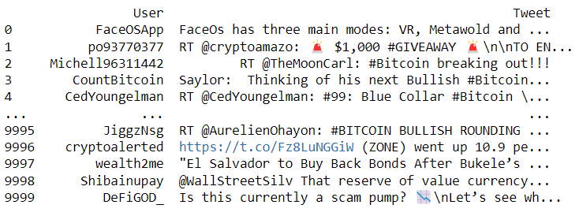
OUTPUT:

Slide 12
Data Cleaning
Removal of unwanted observations
Fixing Structural errors
Managing Unwanted outliers
Handling missing data

Slide 13
Data Cleaning we included
Removal of Emoji's
Coverting data to lowercase
Removing punctions and stopwords
Removing frequently appeared words
Stemming and Lemmatizing

Slide 14
Code
emoji_pattern = re.compile("["
u"\U0001F600-\U0001F64F" # emoticons
u"\U0001F300-\U0001F5FF" # symbols & pictographs
u"\U0001F680-\U0001F6FF" # transport & map symbols
u"\U0001F1E0-\U0001F1FF"# flags (iOS)
u"\U00002702-\U000027B0"
u"\U000024C2-\U0001F251"
"]+", flags=re.UNICODE)
def cleanTxt(text):
text = re.sub(r'@[A-Za-z0-9]+', '', text)
text = re.sub(r'#', '', text)
text = re.sub(r'RT[\s]+', '', text)
text = re.sub(r'https?:\/\/\S+', '', text)
text=emoji_pattern.sub(r'', text)
return text
eth1['Tweet']= eth1['Tweet'].apply(cleanTxt)
eth1

Slide 15
#Creating new dataframe only for tweets
df1_text=eth1[['Tweet']].astype(str)
#Coverting to lower Case
df1_text['Lower_Tweet']=df1_text['Tweet'].str.lower()
#Removing Punctions
punc_to_remove=string.punctuation
def remove_punctuation(text):
return text.translate(str.maketrans('','', punc_to_remove))
df1_text["Tweet_Punc"]=df1_text['Lower_Tweet'].apply(lambda text: remove_punctuation(text))
#Stopwords
",".join(stopwords.words("english"))
STOPWORDS=set(stopwords.words("english"))
def remove_stopword(text):
return " ".join([word for word in str(text).split() if word not in STOPWORDS]
df1_text["Tweet_Stop"]=df1_text['Tweet_Punc'].apply(lambda text: remove_stopword(text))
#Removal of frequently appeared word
for text in df_text['Tweet_Stop'].values:
for word in text.split():
cnt[word]+=1

Slide 16
FREQWORDS = set([w for (w, wc) in cnt.most_common(10)])
def remove_freqwords(text):
"""custom function to remove the frequent words"""
return " ".join([word for word in str(text).split() if word not in FREQWORDS])
df1_text["Tweet_Freq"] = df1_text["Tweet_Stop"].apply(lambda text: remove_freqwords(text))
n_rare_word=10
RAREWORDS=set([w for (w ,wc) in cnt.most_common()[:-n_rare_word-1:-1]])
def remove_rareword(text):
return " ".join([word for word in str(text).split() if word not in RAREWORDS])
df1_text['Rare_text']=df1_text['Tweet_Freq'].apply(lambda text: remove_rareword(text))
#Steamming data
stemmer=PorterStemmer()
def stem_porter(text):
return " ".join([stemmer.stem(word) for word in text.split()]
df1_text["Tweet_Stemmed"]=df1_text['Tweet_Stop'].apply(lambda text : stem_porter(text))
#Lemmatization
lematizer=WordNetLemmatizer()
lemmmatizer=WordNetLemmatizer()
wordnet_map={"N":wordnet.NOUN, "V":wordnet.VERB, "J":wordnet.ADJ, "R":wordnet.ADV}
def lemmatized_words(text):
pos_tagged_text = nltk.pos_tag(text.split())
return " ".join([lematizer.lemmatize(word , wordnet_map.get(pos[0], wordnet.NOUN)) for word, pos in pos_tagged_text]
df1_text["Tweet_Lemma"] = df1_text["Tweet_Stop"].apply(lambda text: lemmatized_words(text))

Slide 17
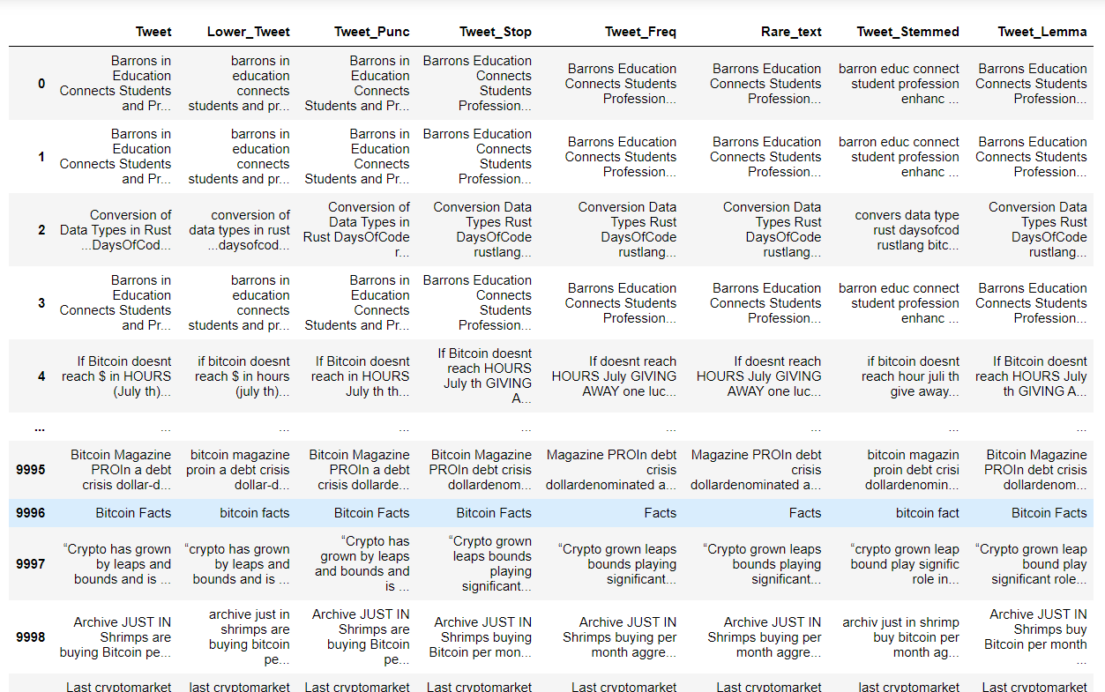
Output

Slide 18
Polarity
It is the expression that determines the sentimental aspect of an opinion. In textual data, the result of sentiment analysis can be determined for each entity in the sentence. The sentiment polarity can be determined as positive, negative and neutral.

Slide 19
Subjectivity
Subjectivity quantifies the amount of personal opinion and factual information contained in the text. The higher subjectivity means that the text contains personal opinion rather than factual information.

Slide 20
Code
def getSubjectivity(text):
return TextBlob(text).sentiment.subjectivity
def getPolarity(text):
return TextBlob(text).sentiment.polarity
df_text['Subjectivity'] = df_text['Tweet_Stop'].apply(getSubjectivity)
df_text['Polarity'] = df_text['Tweet_Stop'].apply(getPolarity)

Slide 21
Classifying Tweets Based on Sentiment
def analysis(score):
if score<0:
return 'negative'
elif score==0:
return 'neutral'
else:
return 'positive'
df_text['Sentiment']=df_text['Polarity'].apply(analysis)

Slide 22
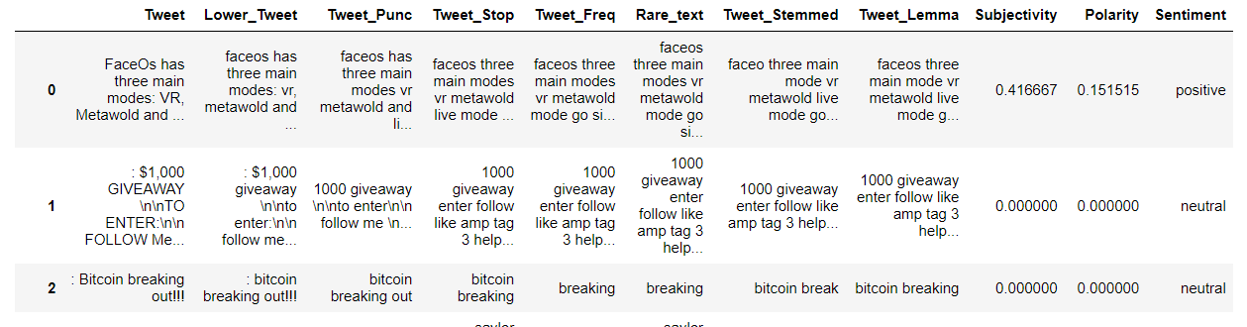
Output

Slide 23
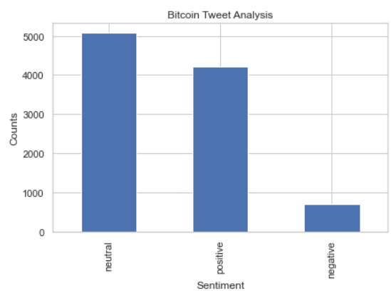
Visualization
df_text['Sentiment'].value_counts()
plt.title('Bitcoin Tweet Analysis')
plt.xlabel('Sentiment')
plt.ylabel('Counts')
df_text['Sentiment'].value_counts().plot(kind='bar')

Slide 24
N-grams
N-grams are continuous sequences of words or symbols or tokens in a document. In technical terms, they can be defined as the neighbouring sequences of items in a document.

Slide 25
Unigram
c_vec = CountVectorizer(stop_words=stopword, ngram_range=(0,1))
# matrix of ngrams
ngrams = c_vec.fit_transform(df1_text['Tweet_Stop'])
# count frequency of ngrams
count_values = ngrams.toarray().sum(axis=0)
# list of ngrams
vocab = c_vec.vocabulary_
df_ngram3 = pd.DataFrame(sorted([(count_values[i],k) for k,i in vocab.items()], reverse=True)).rename(columns={0: 'Frequency', 1:'Unigram'})
df_ngram3['Polarity'] = df_ngram3['Unigram'].apply(lambda x: TextBlob(x).polarity)
df_ngram3['Subjective'] = df_ngram3['Unigram'].apply(lambda x: TextBlob(x).subjectivity)
#Sentiment
def analysis(score):
if score<=-0.6:
return 'negative'
elif score==0.5:
return 'neutral'
elif score>=0.6:
return 'positive'
df_ngram3['Sentiment']=df_ngram3['Polarity'].apply(analysis)
#df_ngram3 = df_ngram3[(df_ngram3['Polarity']>0 and df_ngram3['Polarity']<-0.5)]
df_ngram3 = df_ngram3[df_ngram3["Sentiment"].str.contains("None") == False]

Slide 26
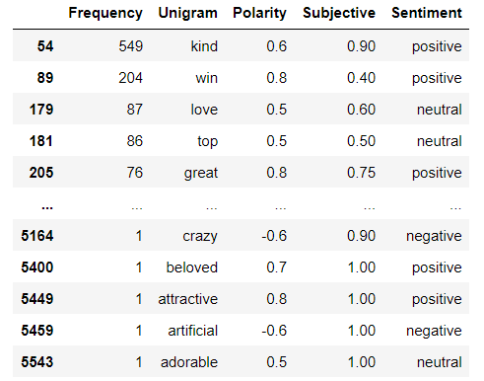
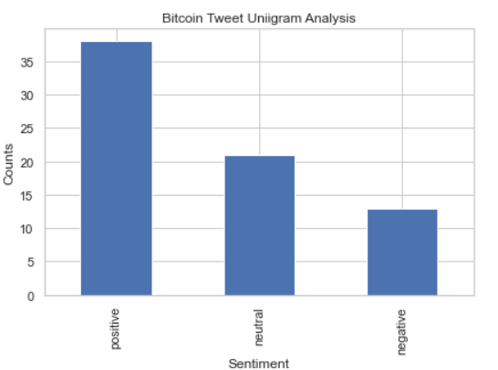
Output

Slide 27
Bigram
c_vec = CountVectorizer(stop_words=stopword, ngram_range=(2,2))
# matrix of ngrams
ngrams = c_vec.fit_transform(df1_text['Tweet_Stop'])
# count frequency of ngrams
count_values = ngrams.toarray().sum(axis=0)
# list of ngrams
vocab = c_vec.vocabulary_
df_ngram4 = pd.DataFrame(sorted([(count_values[i],k) for k,i in vocab.items()], reverse=True)).rename(columns={0: 'Frequency', 1:'Bigram'})
df_ngram4['Polarity'] = df_ngram4['Bigram'].apply(lambda x: TextBlob(x).polarity)
df_ngram4['Subjective'] = df_ngram4['Bigram'].apply(lambda x: TextBlob(x).subjectivity)
#Sentiment
def analysis(score):
if score<=-0.6:
return 'negative'
elif score==0.4:
return 'neutral'
elif score>=0.6:
return 'positive'
df_ngram4['Sentiment']=df_ngram4['Polarity'].apply(analysis)
df_ngram4 = df_ngram4[df_ngram4["Sentiment"].str.contains("None") == False]

Slide 28
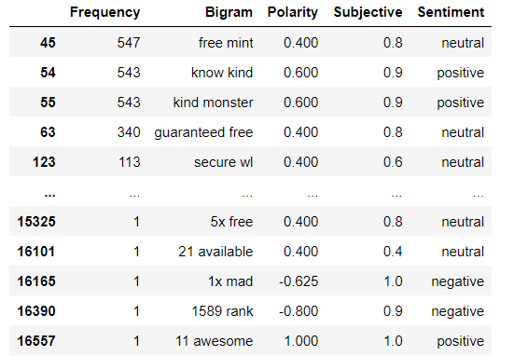
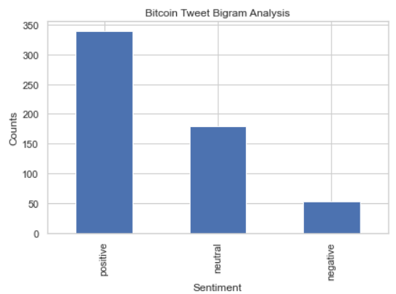
Output

Slide 29
Trigram
c_vec = CountVectorizer(stop_words=stopword, ngram_range=(3,3))
# matrix of ngrams
ngrams = c_vec.fit_transform(df1_text['Tweet_Stop'])
# count frequency of ngrams
count_values = ngrams.toarray().sum(axis=0)
# list of ngrams
vocab = c_vec.vocabulary_
df_ngram5 = pd.DataFrame(sorted([(count_values[i],k) for k,i in vocab.items()], reverse=True)).rename(columns={0: 'Frequency', 1:'Trigram'})
df_ngram5['Polarity'] = df_ngram5['Trigram'].apply(lambda x: TextBlob(x).polarity)
df_ngram5['Subjective'] = df_ngram5['Trigram'].apply(lambda x: TextBlob(x).subjectivity)
#Sentiment
def analysis(score):
if score<=-0.6:
return 'negative'
elif score==0.4:
return 'neutral'
elif score>=0.7:
return 'positive'
df_ngram5['Sentiment']=df_ngram5['Polarity'].apply(analysis)
df_ngram5 = df_ngram5[df_ngram5["Sentiment"].str.contains("None") == False]

Slide 30
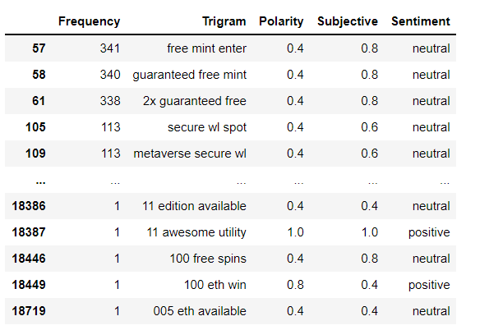
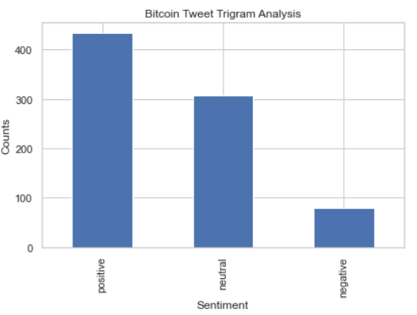
Output

Slide 31
Algorithms Used
NAÏVE BAYERS
LOGISTIC REGRESSION
KNN
RANDOM FOREST
SVM

Slide 32
NAÏVE BAYERS
Naive Bayes is a supervised learning algorithm used for classification tasks.
As other supervised learning algorithms, naive bayes uses features to make a prediction on a target variable. The key difference is that naive bayes assumes that features are independent of each other and there is no correlation between features.
It is a probabilistic classifier, which means it predicts on the basis of the probability of an object.

Slide 33
Advantages of NAÏVE BAYERS
It is simple and easy to implement
It doesn’t require as much training data
It handles both continuous and discrete data
It is highly scalable with the number of predictors and data points
It is fast and can be used to make real-time predictions
It is not sensitive to irrelevant features

Slide 34
Code
Encoding Labels and Making Train-Test Splits
x= data['Tweet_Stop'].values
y = data['Sentiment'].values
x, x_test, y, y_test = train_test_split(x,y, stratify=y, test_size=0.25, random_state=42)
# Vectorize text reviews to numbers
vec = CountVectorizer(stop_words='english')
x = vec.fit_transform(x).toarray()
x_test = vec.transform(x_test).toarray()
#Building the Naive Bayes Classifier
model = MultinomialNB()
model.fit(x, y)
a=model.score(x_test, y_test)
print("Naive Bayes Accuracy score for Bitcoin:",a)

Slide 35
Logistic Regression
Logistic regression is a statistical analysis method to predict a binary outcome, such as yes or no, based on prior observations of a data set. A logistic regression model predicts a dependent data variable by analyzing the relationship between one or more existing independent variables.

Slide 36
Advantages of Logistic Regression
Logistic Regression performs well when the dataset is linearly separable.
Logistic regression is less prone to over-fitting but it can overfit in high dimensional datasets. You should consider Regularization (L1 and L2) techniques to avoid over-fitting in these scenarios.
Logistic Regression not only gives a measure of how relevant a predictor (coefficient size) is, but also its direction of association (positive or negative).
Logistic regression is easier to implement, interpret and very efficient to train.

Slide 37
Code
x= data['Tweet_Stop'].values
y = data['Sentiment'].values
x, x_test, y, y_test = train_test_split(x,y, stratify=y, test_size=0.4, random_state=101)
# Vectorize text reviews to numbers
vec = CountVectorizer(stop_words='english')
x = vec.fit_transform(x).toarray()
x_test = vec.transform(x_test).toarray()
classifier= LogisticRegression(random_state=0)
classifier.fit(x, y)
b=classifier.score(x_test,y_test)
print("Logistic Regression Accuracy score for Bitcoin:",a)

Slide 38
KNN
K-nearest neighbors (KNN) is a type of supervised learning algorithm used for both regression and classification. KNN tries to predict the correct class for the test data by calculating the distance between the test data and all the training points. Then select the K number of points which is closet to the test data.
The KNN algorithm calculates the probability of the test data belonging to the classes of ‘K’ training data and class holds the highest probability will be selected.

Slide 39
Advantages of KNN
No Training Period: KNN is called Lazy Learner (Instance based learning). It does not learn anything in the training period. It does not derive any discriminative function from the training data. In other words, there is no training period for it. It stores the training dataset and learns from it only at the time of making real time predictions. This makes the KNN algorithm much faster than other algorithms that require training e.g. SVM, Linear Regression etc.​
Since the KNN algorithm requires no training before making predictions, new data can be added seamlessly which will not impact the accuracy of the algorithm.​
KNN is very easy to implement. There are only two parameters required to implement KNN i.e. the value of K and the distance function (e.g. Euclidean or Manhattan etc.)​ ​

Slide 40
Code
error_rates=[]
for k in range(1,40):
knn=KNeighborsClassifier(n_neighbors=k)
x= data['Tweet_Stop'].values
y = data['Sentiment'].values
x, x_test, y, y_test = train_test_split(x,y, stratify=y, test_size=0.25, random_state=42)
# Vectorize text reviews to numbers
vec = CountVectorizer(stop_words='english')
x = vec.fit_transform(x).toarray()
x_test = vec.transform(x_test).toarray()
knn.fit(x_test,y_test)
#pred=knn.predict(x_test)
#error_rates.append(np.sum(y_test != pred))
knn=KNeighborsClassifier(n_neighbors=10,p=1)
knn.fit(x_test,y_test)
knn_pred=knn.predict(x_test)
print(classification_report(knn_pred,y_test))
#plt.plot(list(range(1,40)),error_rates,marker='o',mfc='red',mec='red',ms=5,ls='--')
e=knn.score(x_test,y_test)
print("Accuracy score in KNN of bitcoin is ",e)

Slide 41
Random Forest
Random Forest is a classifier that contains a number of decision trees on various subsets of the given dataset and takes the average to improve the predictive accuracy of that dataset." Instead of relying on one decision tree, the random forest takes the prediction from each tree and based on the majority votes of predictions, and it predicts the final output.

Slide 42
Advantages of Random Forest
It can perform both regression and classification tasks.
A random forest produces good predictions that can be understood easily.
It can handle large datasets efficiently.
The random forest algorithm provides a higher level of accuracy in predicting outcomes over the decision tree algorithm.

Slide 43
Code
x= data['Tweet_Stop'].values
y = data['Sentiment'].values
x, x_test, y, y_test = train_test_split(x,y, stratify=y, test_size=0.25, random_state=42)
rf=RandomForestClassifier(n_estimators=20)
rf.fit(x,y)
h=rf.score(x_test,y_test)
print("Accuracy score in Random Forest Classifier is ",h)

Slide 44
SVM
The goal of the SVM algorithm is to create the best line or decision boundary that can segregate n-dimensional space into classes so that we can easily put the new data point in the correct category in the future. This best decision boundary is called a hyperplane.
SVM chooses the extreme points/vectors that help in creating the hyperplane. These extreme cases are called as support vectors, and hence algorithm is termed as Support Vector Machine

Slide 45
Advantages of SVM
SVM works relatively well when there is a clear margin of separation between classes.
SVM is more effective in high dimensional spaces.
SVM is effective in cases where the number of dimensions is greater than the number of samples.
SVM is relatively memory efficient

Slide 46
Code
x= data['Tweet_Stop'].values
y = data['Sentiment'].values
x, x_test, y, y_test = train_test_split(x,y, stratify=y, test_size=0.25, random_state=42)
svc=SVC(C=8,kernel='linear',degree=4)
svc.fit(x,y)
g=svc.score(x_test,y_test)
print("Accuracy score in SVM is ",g)

Slide 47
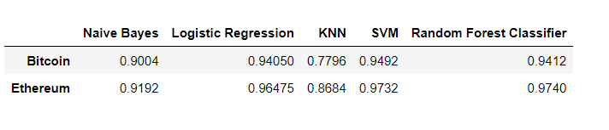
Output
Accuracy Scores from all 5 algorithms for both the cryptocurrencies

Slide 48
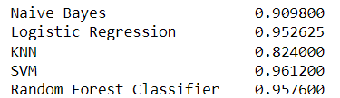
Mean accuracy of algorithm's

Slide 49
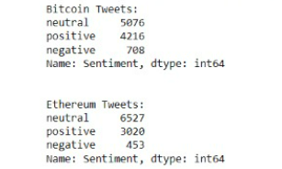
Comparing the cryptocurrencies

Slide 50
Time Line
Collecting data from twitter
Pre-processing data
Classification of data according to its sentiment
Visualization
Comparing different Algorithms

Slide 51
Conclusion
From the analysis of tweets bitcoin has received more positive response compared to ethereum
Algorithm with highest accuracy score is SVM for both the dataset therefore the best algorithm for our sentiment analysis project is SVM

Slide 52
Reference
1.WEBSITES
[1].GEEKS FOR GEEKS
[2]. JAVAPOINT
[3]. WEBSITE-STACK OVERFLOW
2.BOOK
[1]. ‘Machine learning’ by Tom M.Mitchell
3.Research Papers
[1]. Twitter sentiments analyze dataset from Kaggle
[2]. Jin Bai, Jian-Yun Nie. Using Language Models for Text Classification.
[3]. Twitter sentiment analyses report on www.cse.ust.hk
[4]. Natural language processing from Wikipedia

Slide 53
Thanks for our mentor for guiding us through the project

Slide 54
THANK YOU

